Slide 1
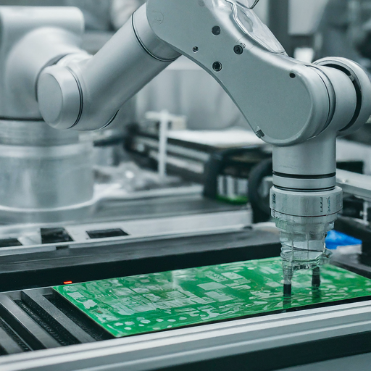
The Rise of Artificial Intelligence: A Revolution in IT
A PRESENTATION BY TABITHA WANJIKU
REG NO:C025-01-0587/2020

Slide 2
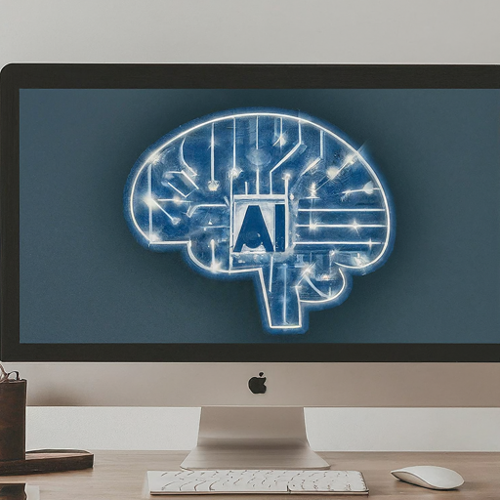
What is Artificial Intelligence?
AI refers to the ability of machines to mimic human cognitive functions like learning and problem-solving.
It involves creating intelligent agents that can reason, learn, and act autonomously.
AI systems are powered by algorithms that can process vast amounts of data and identify patterns

Slide 3
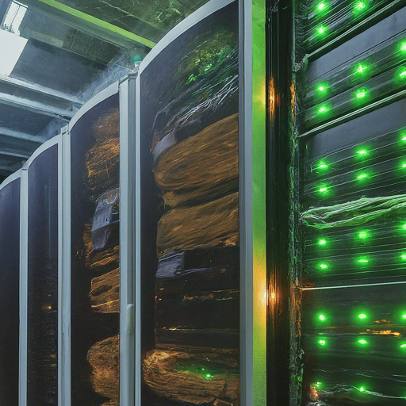
The Rise of AI in IT
AI is revolutionizing various aspects of IT, including:
Data Analytics: AI can analyze massive datasets to extract insights, predict trends, and support data-driven decision-making.
Automation: AI-powered automation can streamline tasks, improve efficiency, and reduce human error.
Cybersecurity: AI can detect and respond to cyber threats in real-time, enhancing network security.
Cloud Computing: AI optimizes resource allocation and workload management in cloud environments.

Slide 4
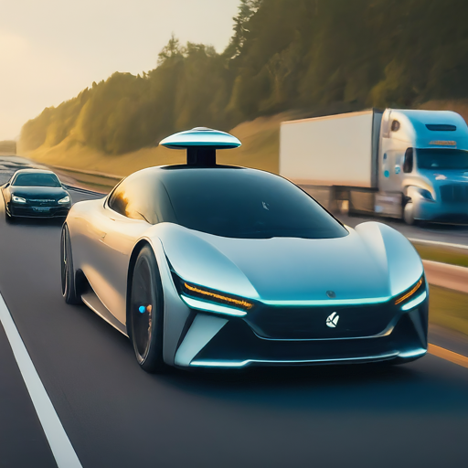
Applications of AI in IT
AI has a wide range of applications in IT, including:
Self-driving cars: AI algorithms are crucial for autonomous vehicles to navigate roads, perceive their surroundings, and make real-time decisions.
Facial recognition: AI systems can recognize faces with high accuracy, used for security purposes and personalized experiences.
Natural Language Processing (NLP): AI enables machines to understand and respond to human language, powering chatbots and virtual assistants.
Machine translation: AI translates languages more accurately and efficiently, breaking down communication barriers.

Slide 5
The Future of AI in IT
The future of AI in IT is full of potential, including:
Personalized IT experiences: AI can tailor IT systems and services to individual user needs and preferences.
Enhanced cybersecurity: AI will play a crucial role in proactively identifying and mitigating cyber threats.
Human-AI collaboration: IT professionals will work alongside AI systems, leveraging their strengths for greater efficiency and innovation.

Slide 6
Conclusion
AI is a powerful technology with the potential to revolutionize the world.
In the field of IT, AI is driving innovation, improving efficiency, and creating new opportunities.
As we move forward, it's important to embrace the potential of AI while addressing ethical concerns and ensuring its responsible development.

